Slide 1

Quantum Computer Programming
Qiskit Section
Andrés Muñoz-Moller
Quantum Information and Computing Team

Slide 2
Contents of Qiskit Section
Quantum Information and Quantum Computing Basics
Quantum Circuits and Noisy Simulators
Quantum Circuit Transpilation
Fault-Tolerant Quantum Computing: QPE and Shor’s Algorithm
Qiskit Primitives and Qiskit Runtime
Variational Algorithms: VQE and QAOA

Slide 3
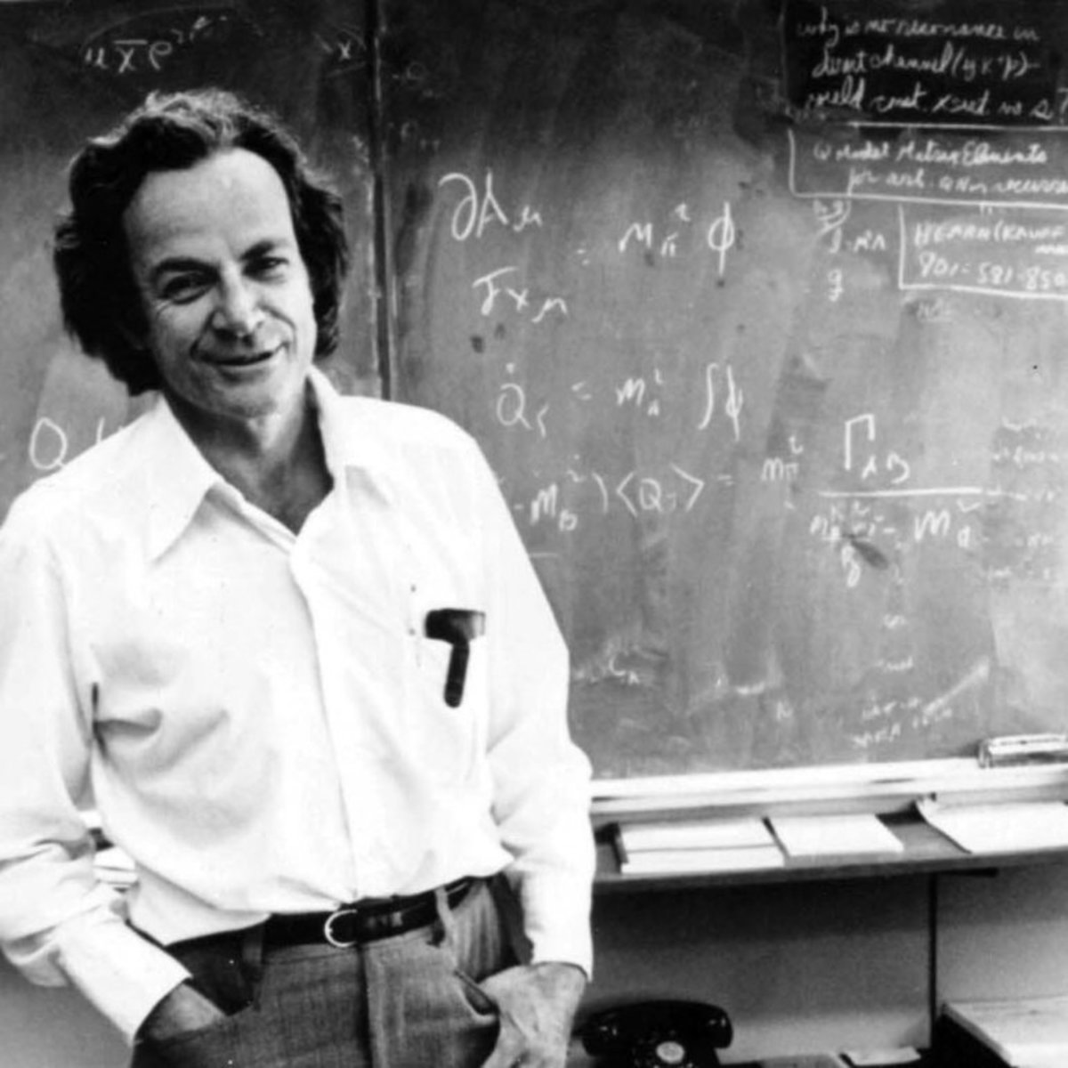
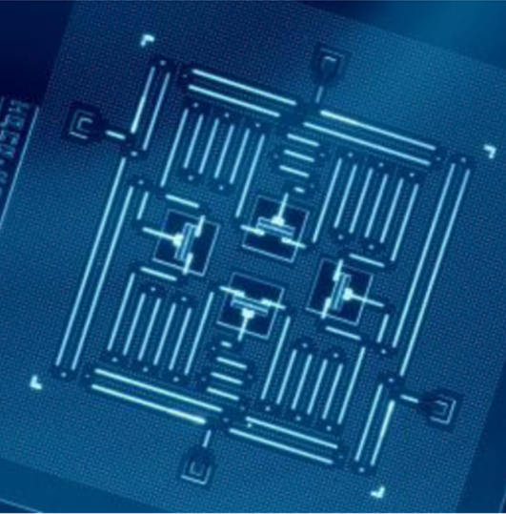
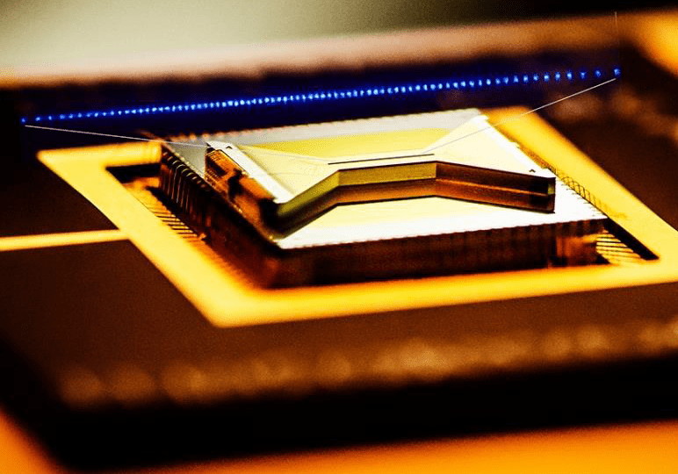
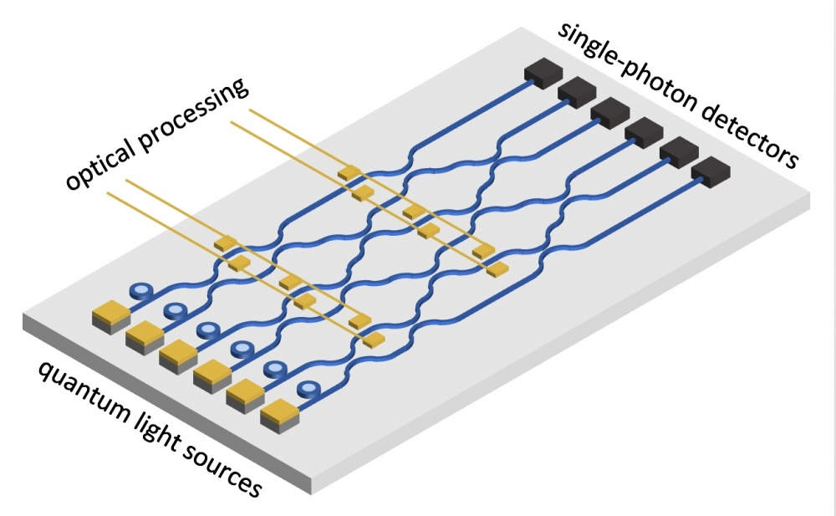
What is Quantum Computing (QC)?
Proposed by Richard Feynman in 1982 for simulating quantum systems.
QC use the principles of quantum mechanics to perform computations, exploiting quantum phenomena like superpositions, entanglement and decoherence.
Several QC architectures:
Superconductors
Atom and Ion traps
Photonic
Notes:
IBM Quantum Computers architecture corresponds to superconducting qubits.

Slide 4
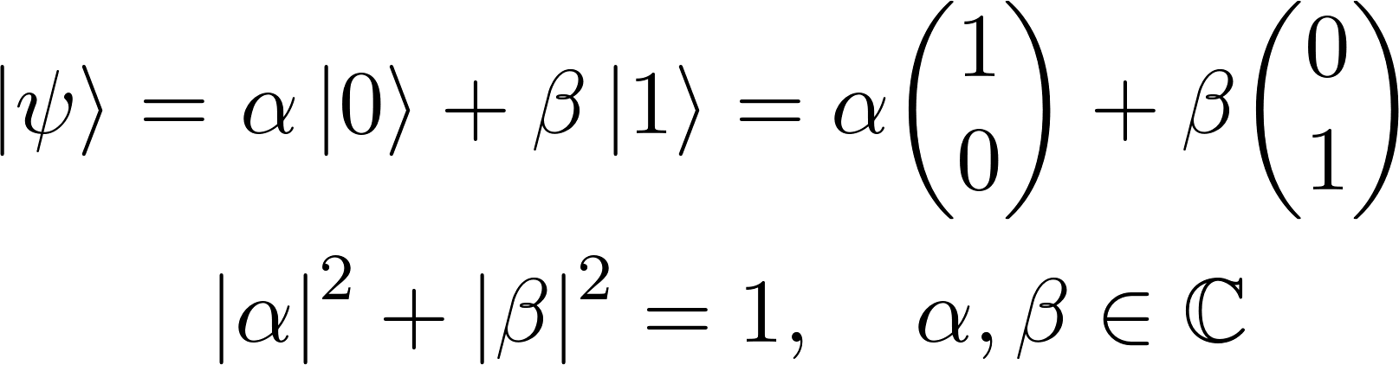
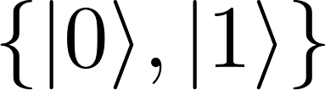
Classical Bits vs Quantum Bits
Classical Bit → System that has classical states 0 or 1.
Quantum States → Unit (column) vectors in a Hilbert space.
Qubit (Quantum bit) → Quantum state in a two-dimensional Hilbert space.
Computational Basis
Probability Amplitudes
Superposition of states = Linear combination of the basis states.
Notes:
Bit = smallest piece of information you can have
Classical system = Transistor, blocks electric current corresponds to the 0 state, if it passes then its 1.
Quantum State is the mathematical object that describes the knowledge of a quantum system.
Hilbert space -> Vector Space over the complex numbers
Qubit = smallest piece of quantum information you can have

Slide 5
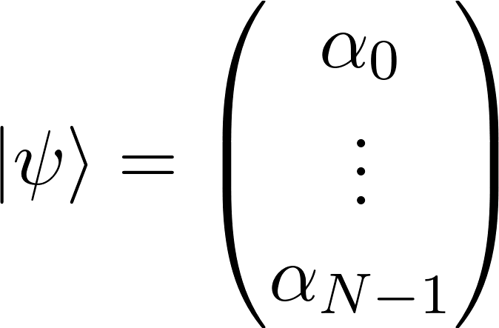
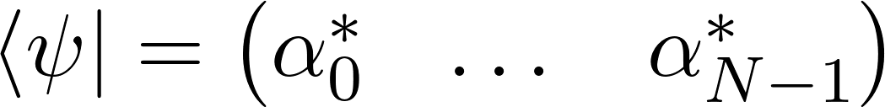
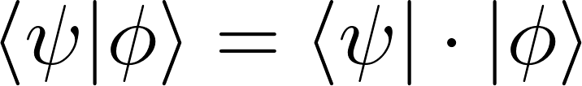
Dirac Notation
Bra → N-dimensional column vector
Ket → Conjugate transpose → Row vector
Braket → Inner product
Notes:
The bracket gives us a complex number
If psi = phi, then the bracket describes the norm of the quantum state (which has to be one)

Slide 6

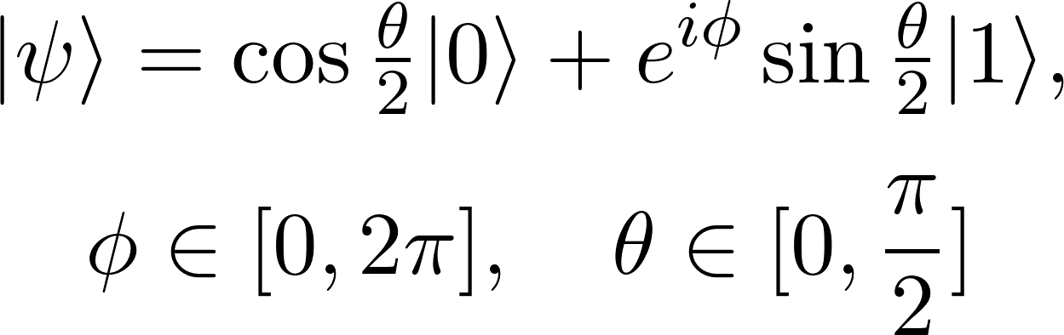
Bloch Sphere
Single qubit quantum states can also be represented using the Bloch sphere representation.
Notes:
The state psi is in the surface of the sphere.

Slide 7
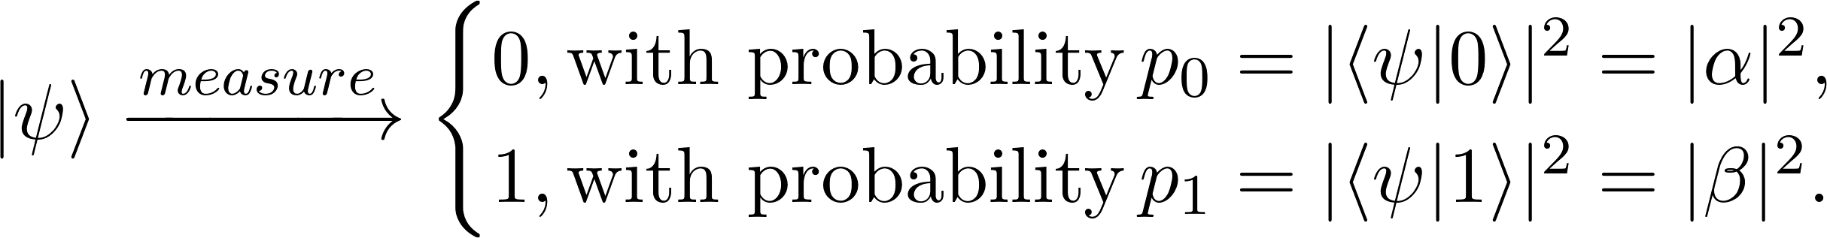
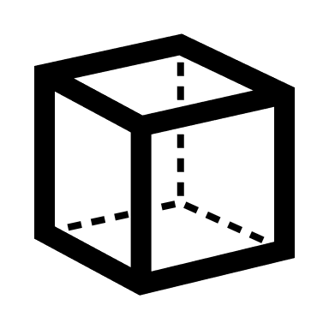
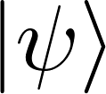
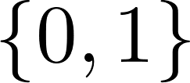
Measuring a quantum state
We cannot observe the state vector of a qubit directly.
To obtain information from a qubit we must perform a measurement (usually in the computational basis) → Probabilistic!
Qubit
Measurement
Bit
Notes:
Remember that this vectors correspond to mathematical constructs that represent the physical (quantum) system
We recover the amplitudes by repeatedly preparing and measuring the state
After measuring the states “collapses” onto one of the basis elements

Slide 8
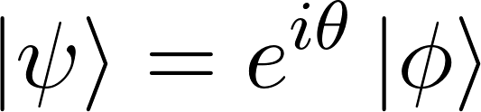
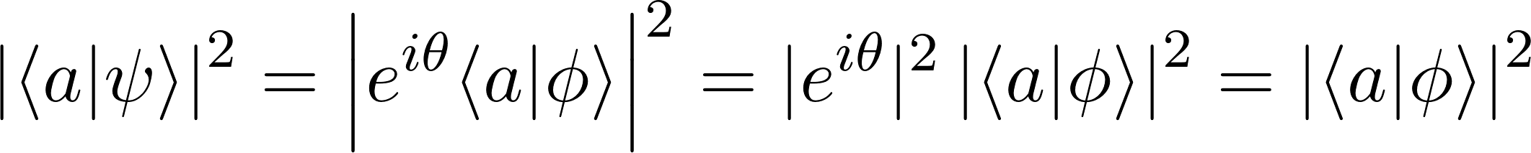
Global and relative phases
Global Phase
Vectors that differ by a global phase represent the same quantum state: the probability amplitudes upon measuring are equal for both vectors.
On the other hand, a relative phase can affect measurement outcomes (e.g. if measured in a basis other than the computational basis.)
Relative Phase

Slide 9


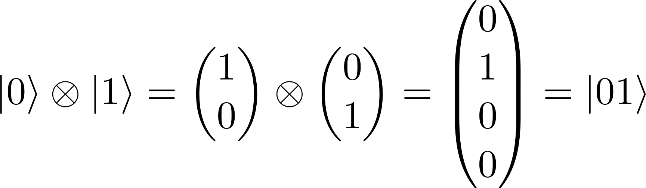
Multiple Bits/Qubits
Classical state of multiple bits (Bitstring) → Cartesian product.
Quantum states of multiple qubits → Tensor product.

Slide 10
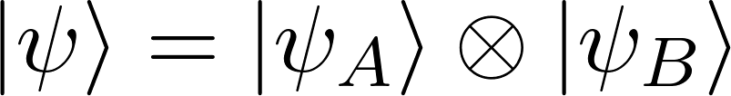
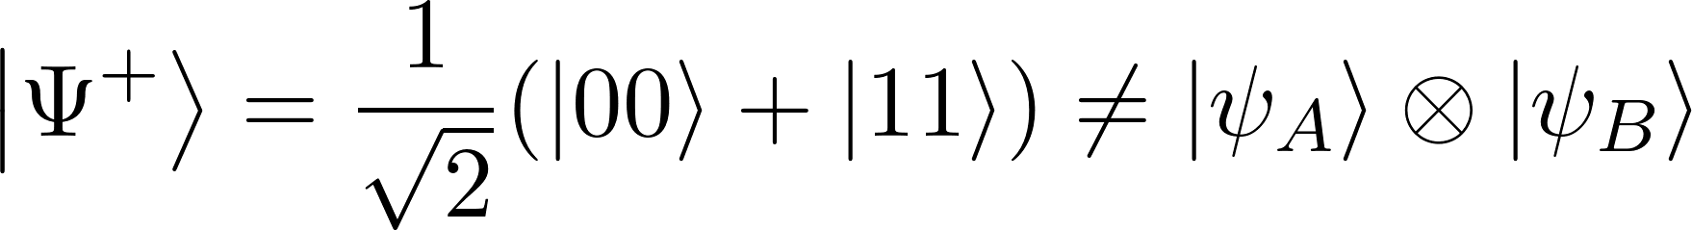
Entanglement
Product States → States that can be written as a tensor product.
Entangled States → States that cannot be written as a tensor product (e.g. Bell states).

Slide 11
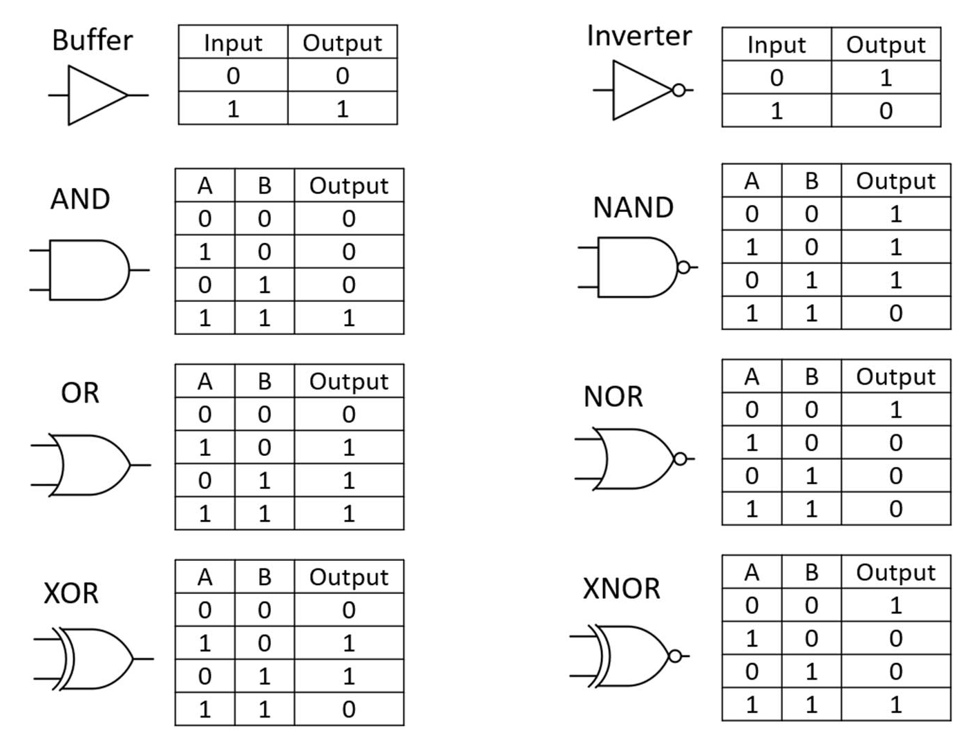
Classical Gates
In a classical circuit, we perform operations on bits using classical (logical) gates.
For single bits, the only gates available are the buffer and the NOT (inverter) gate.

Slide 12
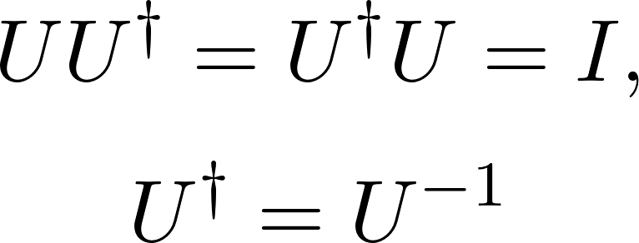
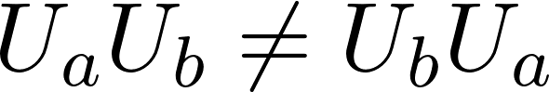
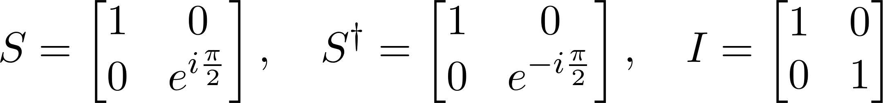
Quantum Gates
Conjugate transpose
As qubits correspond to quantum states, our quantum gates correspond to unitary operations.
Quantum gates are reversible, whereas most classical logical gates are not (e.g. AND gate).
In general, gates do not commute!
Notes:
If we can represent a qubit as vector of dimension two, then we can represent a unitary operator as a 2 by 2 matrix.

Slide 13
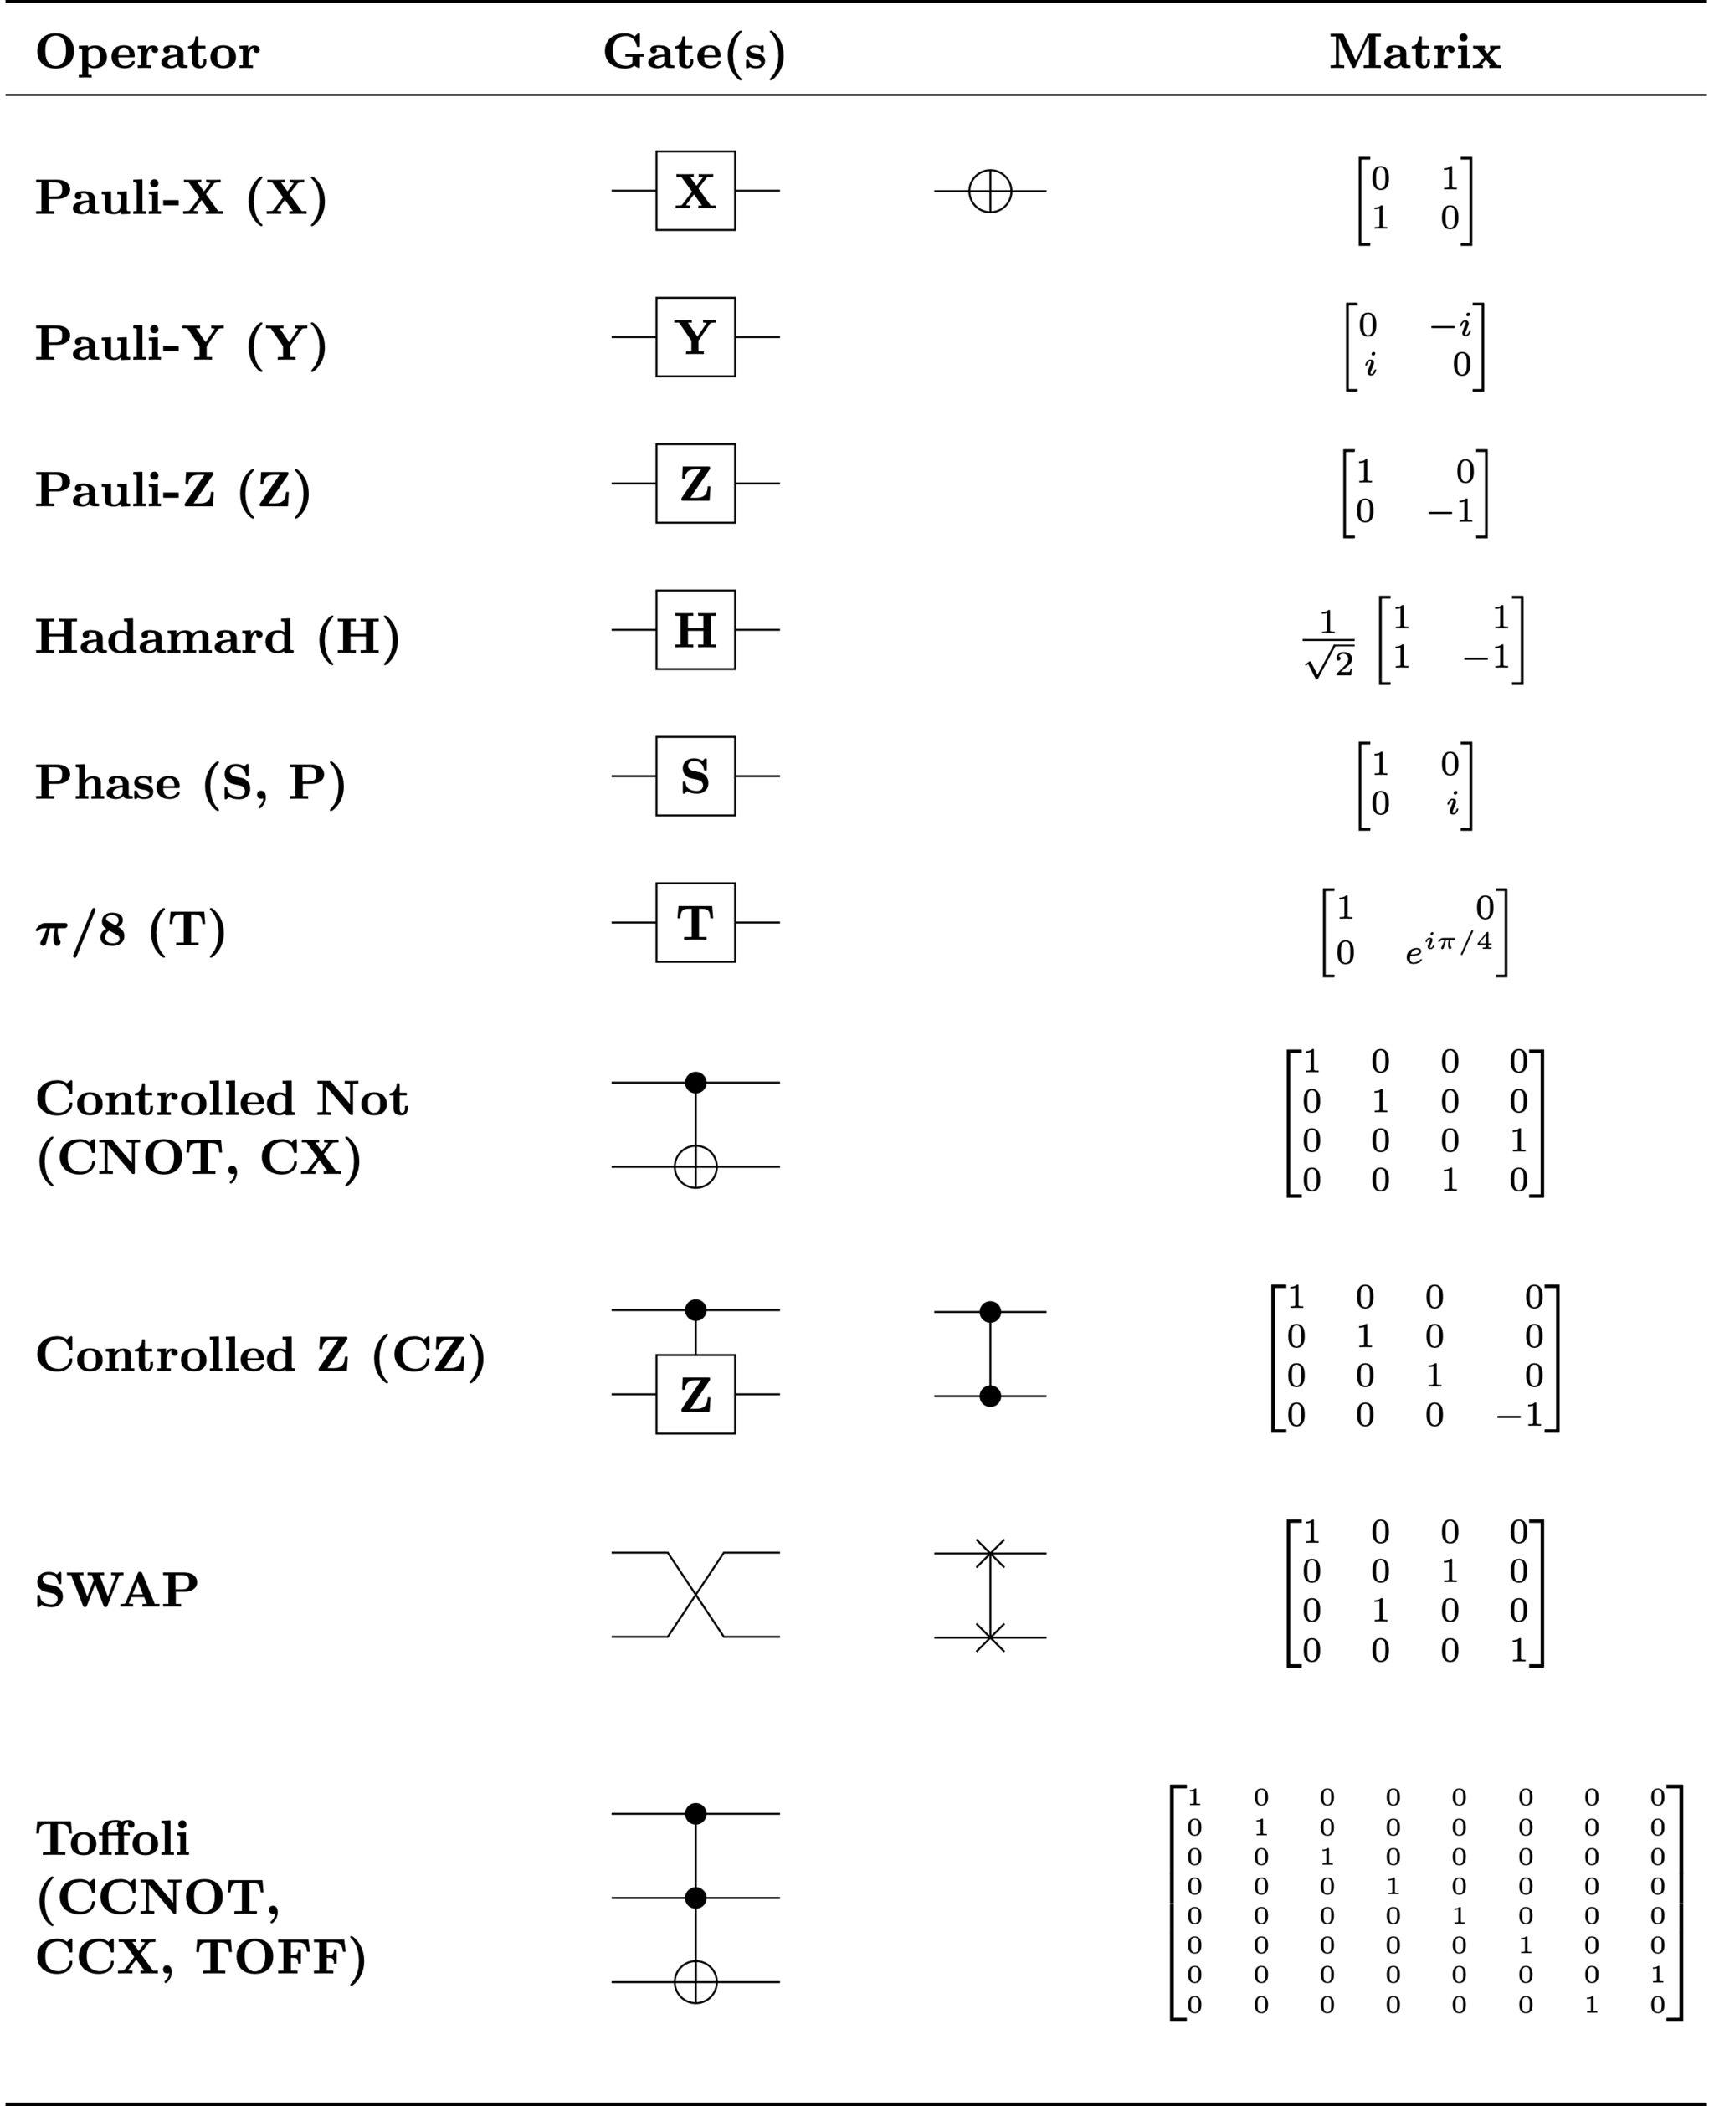
Examples Single Qubit Quantum Gates

Slide 14
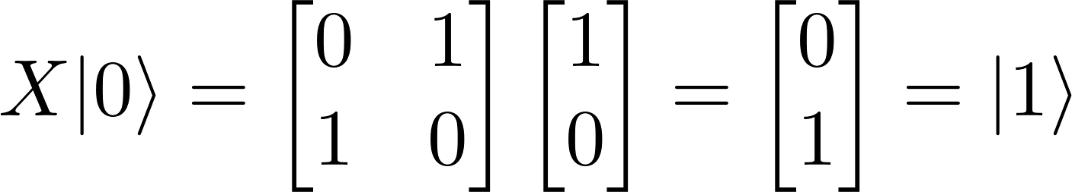
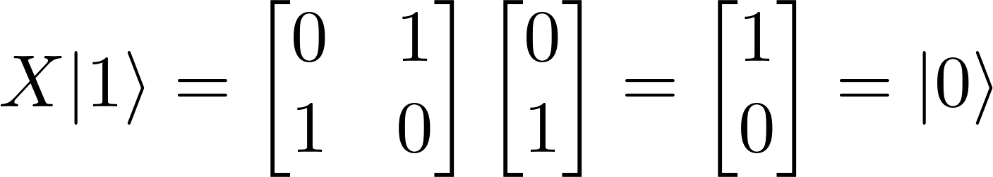
X Gate (NOT Gate)

Slide 15
Y Gate and Z Gate
Global phases
Eigenvectors
Notes:
The states 0 and 1 are eigenvectors of the Pauli Z matrix (Z Gate), therefore the computational basis is also called the Pauli Z basis

Slide 16
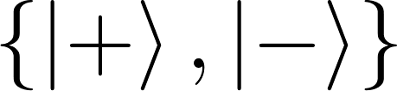
Hadamard Gate
The Hadamard Gate creates an equal superposition state if given a computational basis state.
Relative Phase
Pauli X basis

Slide 17
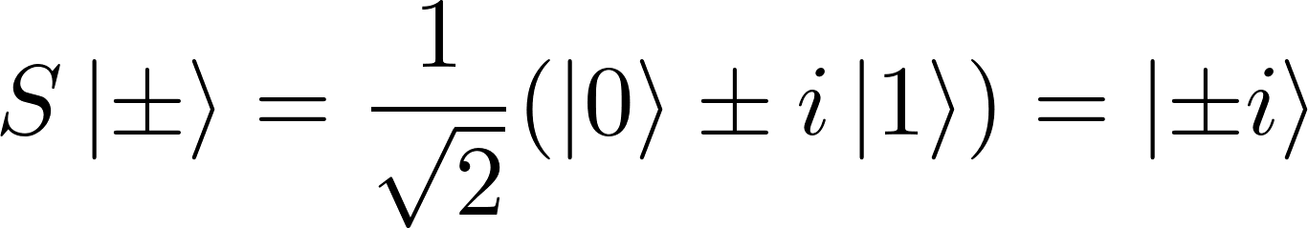
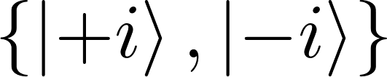
Phase Gate
The Phase Gate (S) induces a pi-half phase.
Pauli Y basis

Slide 18
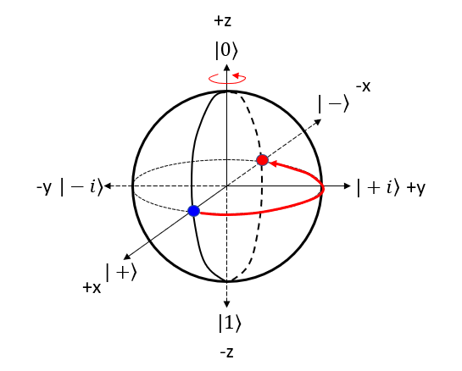
Rotations in the Bloch sphere
Single qubit gates are rotations around the Bloch sphere.
(X ,Y, Z) Gate → 180° rotation over the (X, Y, Z) Axis.
H Gate → 90° rotation over Y-Axis + 180° rotation over the X-Axis.
S Gate → 90° rotation over the Z-Axis.

Slide 19
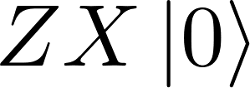
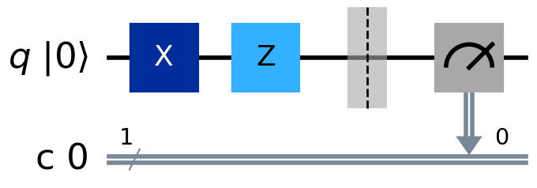
Quantum Circuit Model
Final State
Quantum Gates
Initial State
Quantum Register
Classical Register
Measurement
Time Progress

Slide 20
Multiqubit Gates

Slide 21
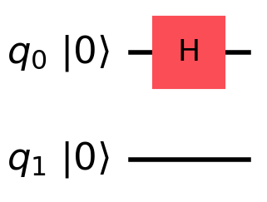
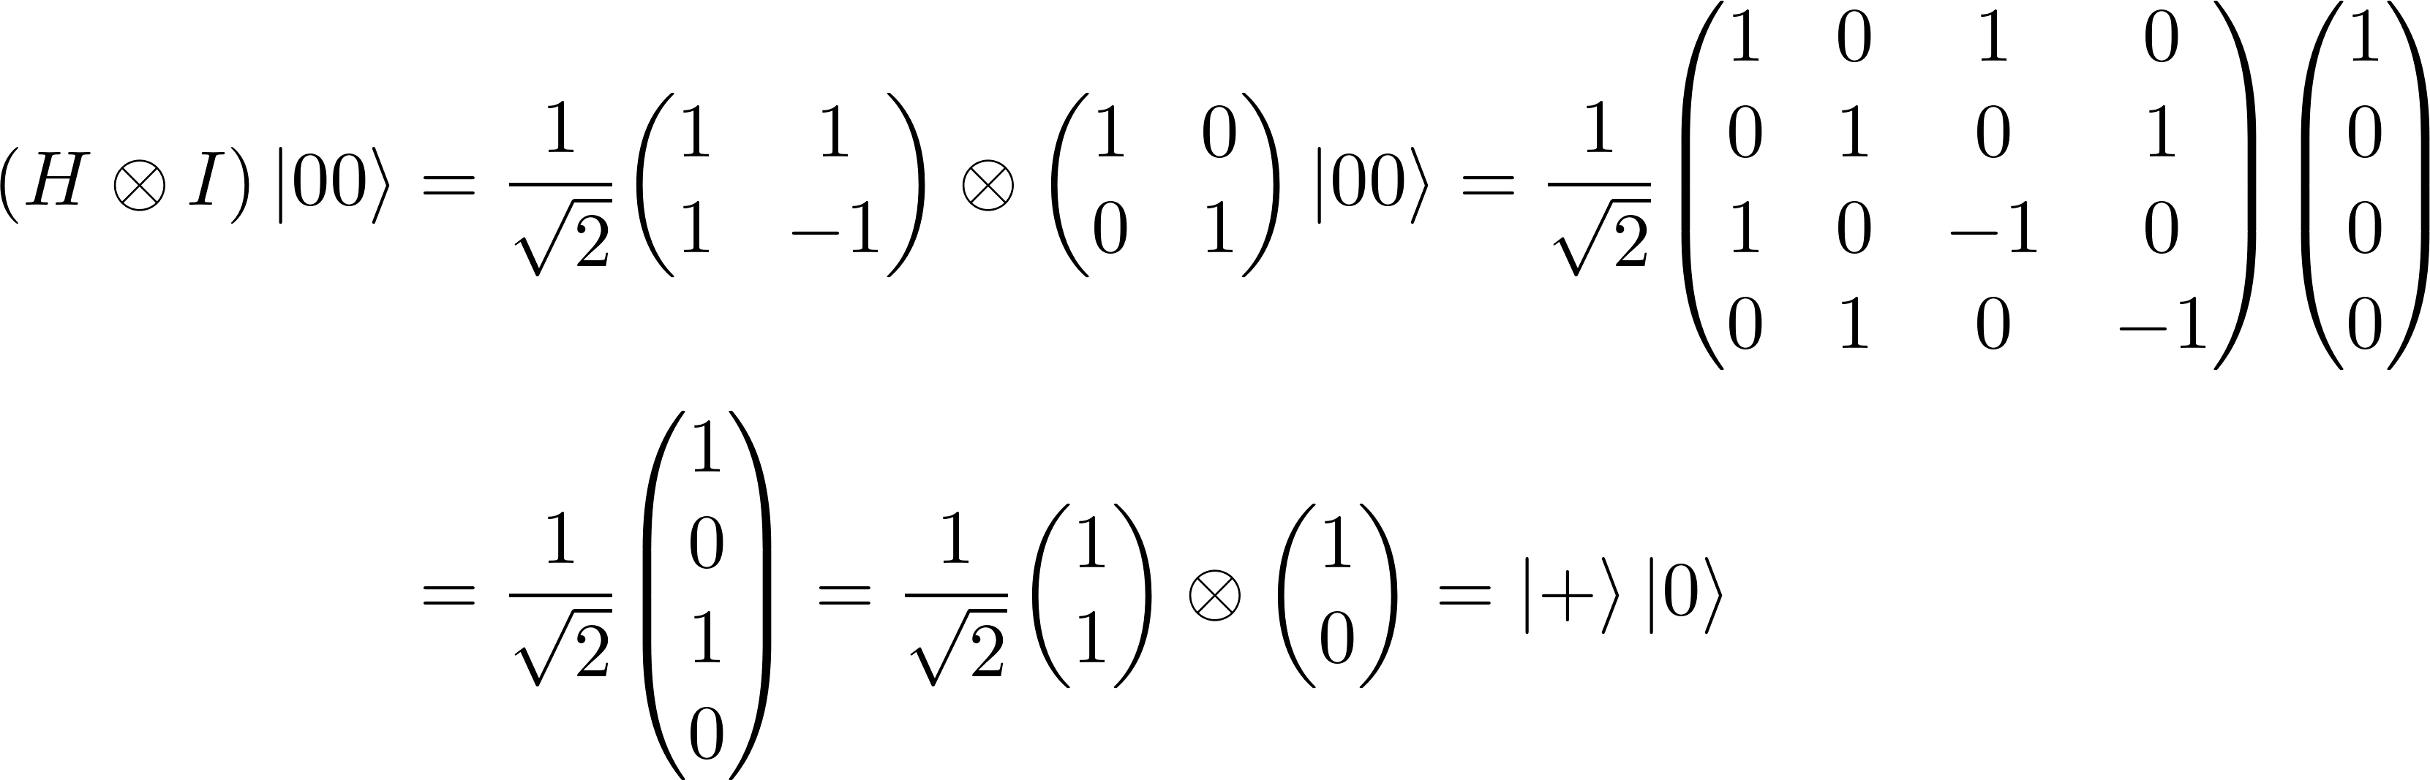
Local Gates
Local gates → Gates that act non-trivially only on a single qubit.

Slide 22
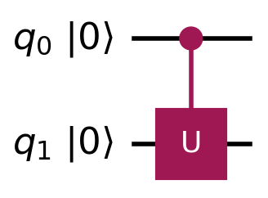
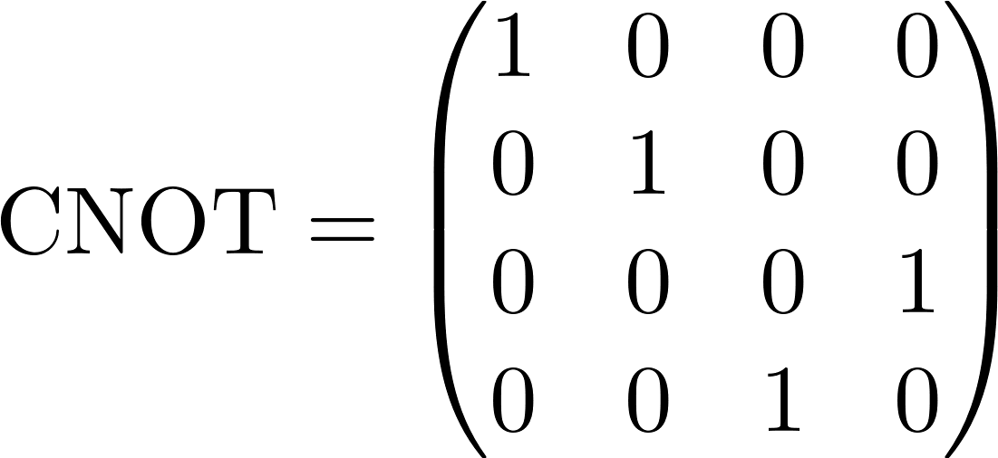
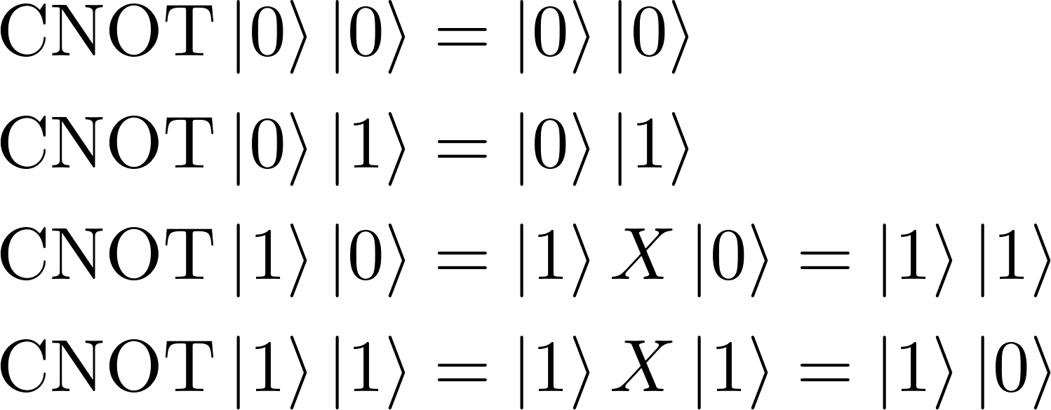
Controlled Gates
Control qubit
Control gates apply a unitary gate to the target qubit(s) if the control qubit(s) is 1.
Common examples: CNOT (CX), CZ and Toffoli gate.
Target qubit

Slide 23
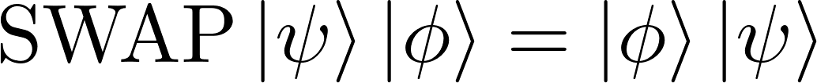
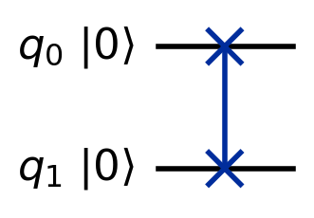
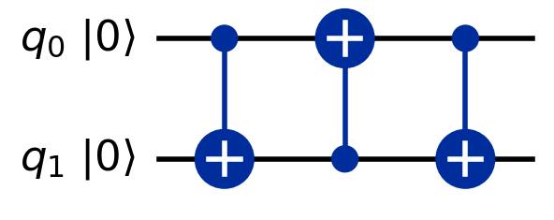
SWAP Gate
The SWAP gate is a gate that swaps the states of two qubits.

Slide 24
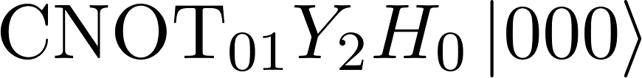
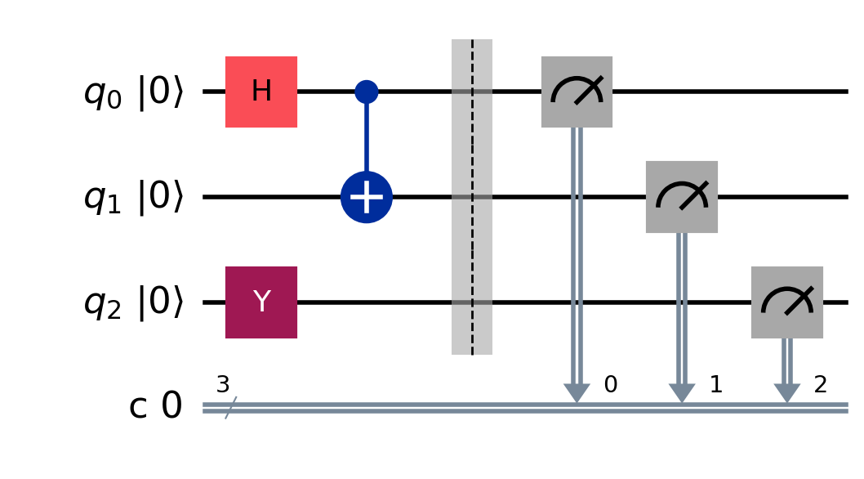
Quantum Circuit Model

Slide 25

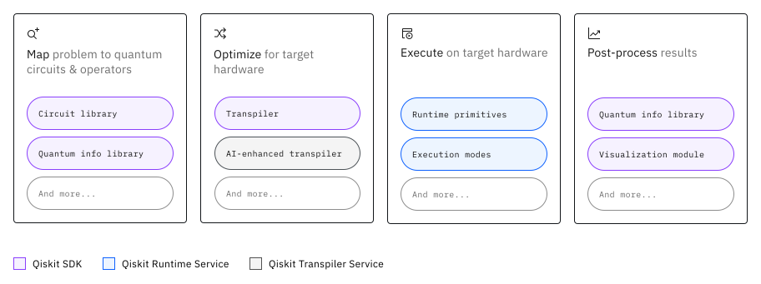
What is Qiskit?
Qiskit is a software stack for quantum computing.
Qiskit SDK: Open-source SDK for working with quantum computers (or simulators) at the level of quantum circuits, quantum operators and primitives functions.
Qiskit Runtime: Environment for executing workloads in IBM Quantum Computers.
Qiskit Ecosystem: Collection of tools created by the community (researchers and developers).

Slide 26

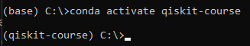
Things to do before starting
Install Python 3.12 (Preferably using Anaconda)
Optional: Create a minimal environment.
Install Qiskit and Qiskit-related packages:
pip install qiskit
pip install qiskit-ibm-runtime
pip install qiskit[visualization]
pip install qiskit-aer
pip install rustworkx
Optional: Install VS Code (or use Jupyter Notebook/Google Colab) and Graphviz.

